Slide 1

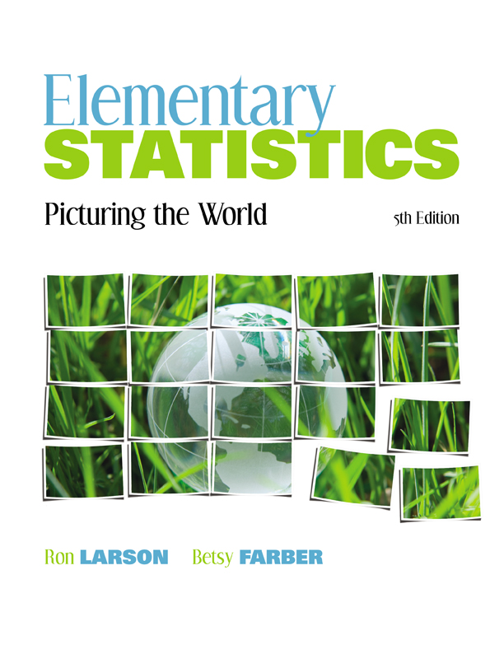

Chapter
5
Normal Probability Distributions
© 2012 Pearson Education, Inc.
All rights reserved.
<number> of 105

Slide 2
Chapter Outline
5.1 Introduction to Normal Distributions and the
Standard Normal Distribution
© 2012 Pearson Education, Inc. All rights reserved.
<number> of 105

Slide 3
Section 5.1
Introduction to Normal Distributions
© 2012 Pearson Education, Inc. All rights reserved.
<number> of 105

Slide 4
Section 5.1 Objectives
Interpret graphs of normal probability distributions
Find areas under the standard normal curve
© 2012 Pearson Education, Inc. All rights reserved.
<number> of 105

Slide 5
Properties of a Normal Distribution
Continuous random variable
Has an infinite number of possible values that can be represented by an interval on the number line.
Continuous probability distribution
The probability distribution of a continuous random variable.
Hours spent studying in a day
The time spent studying can be any number between 0 and 24.
0
3
6
9
12
15
18
21
24
© 2012 Pearson Education, Inc. All rights reserved.
<number> of 105

Slide 6
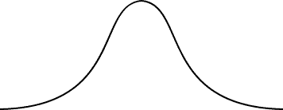
Properties of Normal Distributions
Normal distribution
A continuous probability distribution for a random variable, x.
The most important continuous probability distribution in statistics.
The graph of a normal distribution is called the normal curve.
x
© 2012 Pearson Education, Inc. All rights reserved.
<number> of 105

Slide 7
Properties of Normal Distributions
The mean, median, and mode are equal.
The normal curve is bell-shaped and is symmetric about the mean.
The total area under the normal curve is equal to 1.
The normal curve approaches, but never touches, the x-axis as it extends farther and farther away from the mean.
Total area = 1
μ
x
© 2012 Pearson Education, Inc. All rights reserved.
<number> of 105

Slide 8
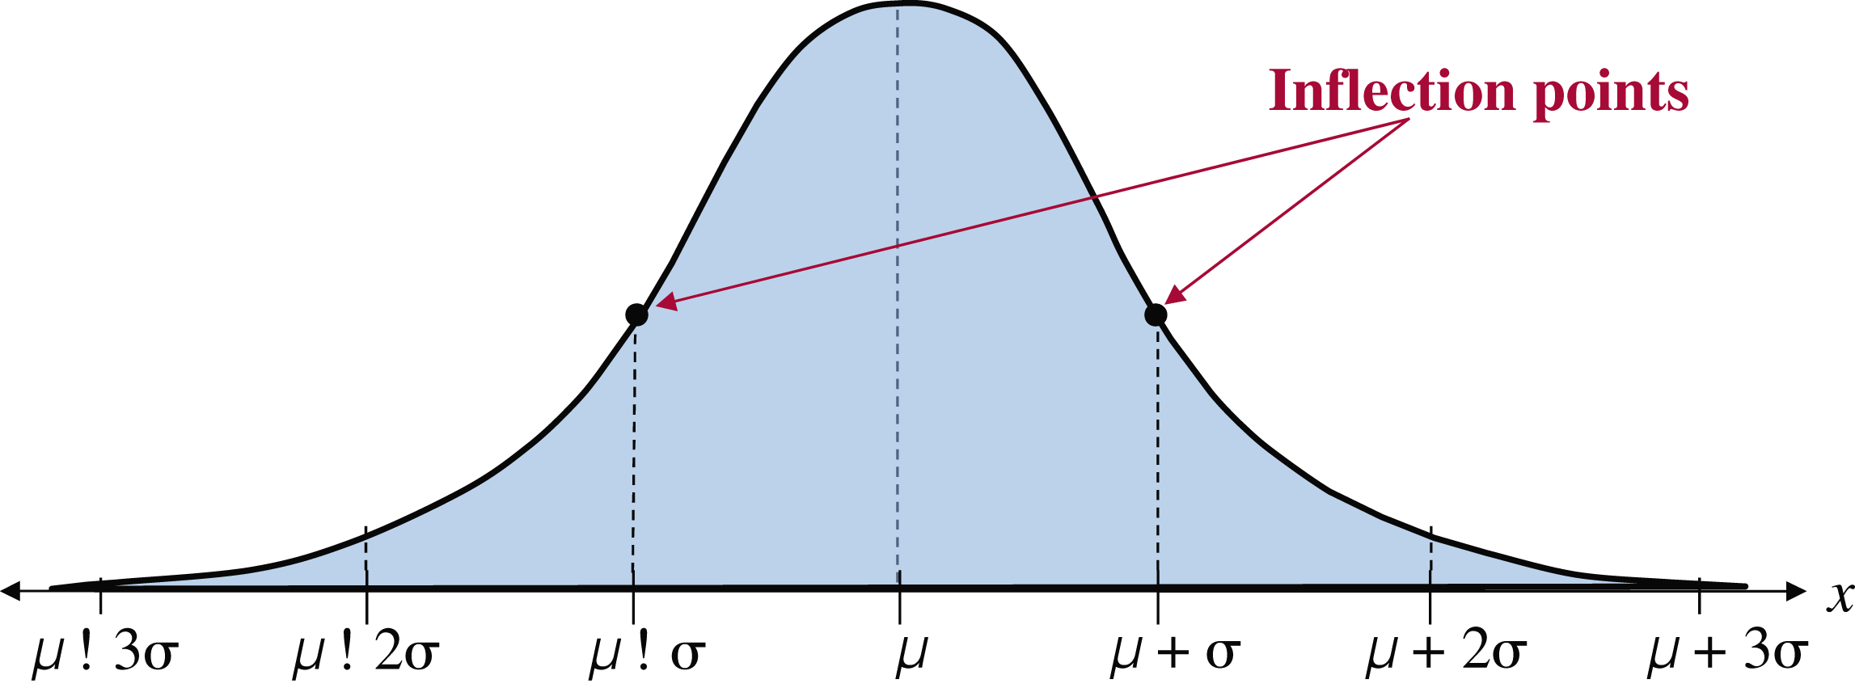
Properties of Normal Distributions
Between μ – σ and μ + σ (in the center of the curve), the graph curves downward. The graph curves upward to the left of μ – σ and to the right of μ + σ. The points at which the curve changes from curving upward to curving downward are called the inflection points.
μ – 3σ
μ – 2σ
μ – σ
μ
μ + σ
μ + 2σ
μ + 3σ
© 2012 Pearson Education, Inc. All rights reserved.
<number> of 105

Slide 9
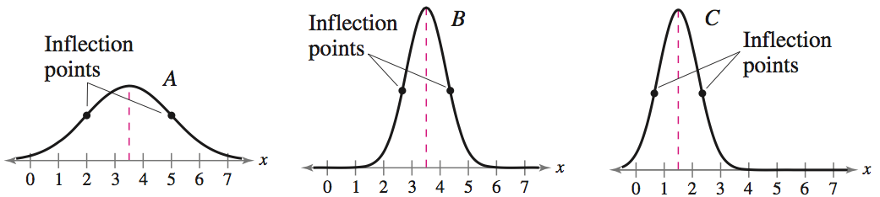
Means and Standard Deviations
A normal distribution can have any mean and any positive standard deviation.
The mean gives the location of the line of symmetry.
The standard deviation describes the spread of the data.
μ = 3.5
σ = 1.5
μ = 3.5
σ = 0.7
μ = 1.5
σ = 0.7
© 2012 Pearson Education, Inc. All rights reserved.
<number> of 105

Slide 10
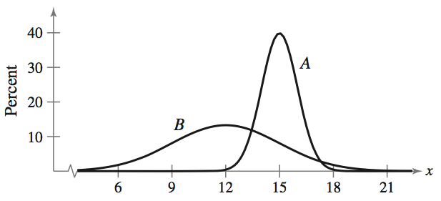
Example: Understanding Mean and Standard Deviation
Which normal curve has the greater mean?
Solution:
Curve A has the greater mean (The line of symmetry of curve A occurs at x = 15. The line of symmetry of curve B occurs at x = 12.)
© 2012 Pearson Education, Inc. All rights reserved.
<number> of 105

Slide 11
Example: Understanding Mean and Standard Deviation
Which curve has the greater standard deviation?
Solution:
Curve B has the greater standard deviation (Curve B is more spread out than curve A.)
© 2012 Pearson Education, Inc. All rights reserved.
<number> of 105

Slide 12
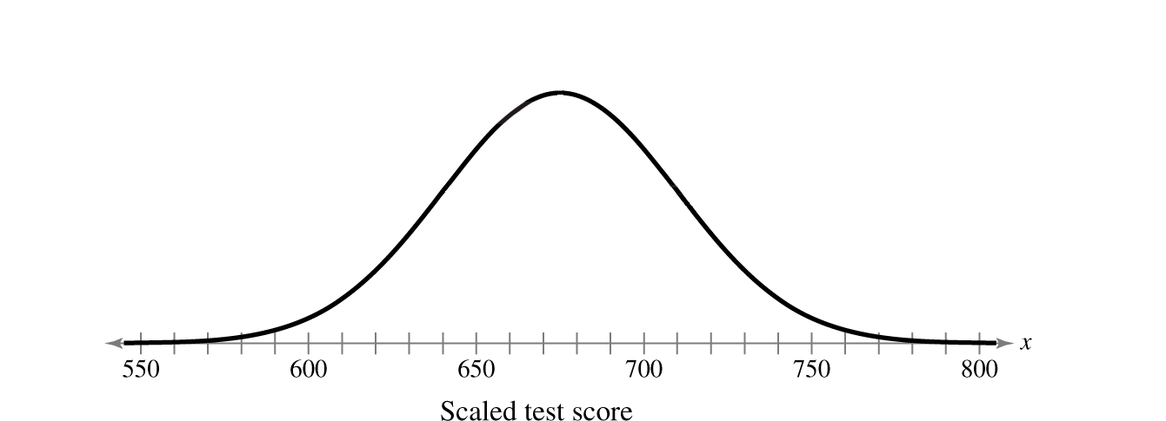
Example: Interpreting Graphs
The scaled test scores for the New York State Grade 8 Mathematics Test are normally distributed. The normal curve shown below represents this distribution. What is the mean test score? Estimate the standard deviation.
Solution:
Because the inflection points are one standard deviation from the mean, you can estimate that σ ≈ 35.
Because a normal curve is symmetric about the mean, you can estimate that μ ≈ 675.
© 2012 Pearson Education, Inc. All rights reserved.
<number> of 105

Slide 13
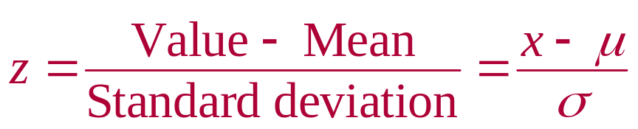
The Standard Normal Distribution
Standard normal distribution
A normal distribution with a mean of 0 and a standard deviation of 1.
Area = 1
z
–3
–2
–1
0
1
2
3
Any x-value can be transformed into a z-score by using the formula
© 2012 Pearson Education, Inc. All rights reserved.
<number> of 105

Slide 14
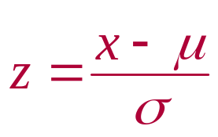
The Standard Normal Distribution
If each data value of a normally distributed random variable x is transformed into a z-score, the result will be the standard normal distribution.
Standard Normal Distribution
Normal Distribution
σ
σ = 1
μ
x
μ = 0
z
Use the Standard Normal Table to find the cumulative area under the standard normal curve.
© 2012 Pearson Education, Inc. All rights reserved.
<number> of 105

Slide 15
Properties of the Standard Normal Distribution
The cumulative area is close to 0 for z-scores close to z = –3.49.
The cumulative area increases as the z-scores increase.
Area is close to 0
z
–3
–2
–1
0
1
2
3
z = –3.49
© 2012 Pearson Education, Inc. All rights reserved.
<number> of 105

Slide 16
Properties of the Standard Normal Distribution
The cumulative area for z = 0 is 0.5000.
The cumulative area is close to 1 for z-scores close to z = 3.49.
Area is close to 1
z
–3
–2
–1
0
1
2
3
z = 3.49
z = 0
Area is 0.5000
© 2012 Pearson Education, Inc. All rights reserved.
<number> of 105

Slide 17

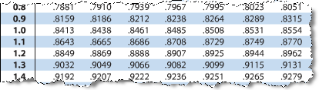
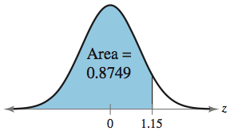
Example: Using The Standard Normal Table
Find the cumulative area that corresponds to a z-score of 1.15.
Solution:
Find 1.1 in the left hand column.
Move across the row to the column under 0.05
The area to the left of z = 1.15 is 0.8749.
© 2012 Pearson Education, Inc. All rights reserved.
<number> of 105

Slide 18


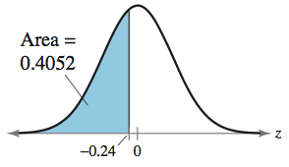
Example: Using The Standard Normal Table
Find the cumulative area that corresponds to a z-score of –0.24.
Solution:
Find –0.2 in the left hand column.
Move across the row to the column under 0.04
The area to the left of z = –0.24 is 0.4052.
© 2012 Pearson Education, Inc. All rights reserved.
<number> of 105

Slide 19
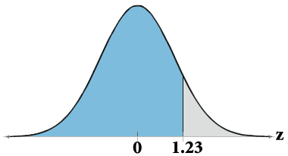
Finding Areas Under the Standard Normal Curve
Sketch the standard normal curve and shade the appropriate area under the curve.
Find the area by following the directions for each case shown.
  To find the area to the left of z, find the area that corresponds to z in the Standard Normal Table.
The area to the left of z = 1.23 is 0.8907
Use the table to find the area for the z-score
© 2012 Pearson Education, Inc. All rights reserved.
<number> of 105

Slide 20
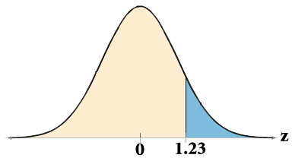
Finding Areas Under the Standard Normal Curve
  To find the area to the right of z, use the Standard Normal Table to find the area that corresponds to z. Then subtract the area from 1.
The area to the left of z = 1.23 is 0.8907.
Subtract to find the area to the right of z = 1.23: 1 – 0.8907 = 0.1093.
Use the table to find the area for the z-score.
© 2012 Pearson Education, Inc. All rights reserved.
<number> of 105

Slide 21
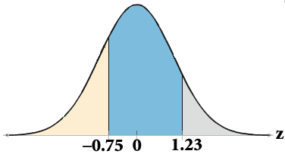
Finding Areas Under the Standard Normal Curve
  To find the area between two z-scores, find the area corresponding to each z-score in the Standard Normal Table. Then subtract the smaller area from the larger area.
The area to the left of z = 1.23 is 0.8907.
Subtract to find the area of the region between the two z-scores: 0.8907 – 0.2266 = 0.6641.
The area to the left of z = –0.75 is 0.2266.
Use the table to find the area for the z-scores.
© 2012 Pearson Education, Inc. All rights reserved.
<number> of 105

Slide 22
Example: Finding Area Under the Standard Normal Curve
Find the area under the standard normal curve to the left of z = –0.99.
Solution:
0.1611
z
–0.99
0
From the Standard Normal Table, the area is equal to 0.1611.
© 2012 Pearson Education, Inc. All rights reserved.
<number> of 105

Slide 23
Example: Finding Area Under the Standard Normal Curve
Find the area under the standard normal curve to the right of z = 1.06.
Solution:
0.8554
1 – 0.8554 = 0.1446
z
0
1.06
From the Standard Normal Table, the area is equal to 0.1446.
© 2012 Pearson Education, Inc. All rights reserved.
<number> of 105

Slide 24
Example: Finding Area Under the Standard Normal Curve
Find the area under the standard normal curve between z = –1.5 and z = 1.25.
Solution:
0.8944 – 0.0668 = 0.8276
0.8944
0.0668
z
–1.50
0
1.25
From the Standard Normal Table, the area is equal to 0.8276.
© 2012 Pearson Education, Inc. All rights reserved.
<number> of 105

Slide 25
Section 5.1 Summary
Interpreted graphs of normal probability distributions
Found areas under the standard normal curve
© 2012 Pearson Education, Inc. All rights reserved.
<number> of 105

